Slide 1
Fuselage Intro and Physics

Slide 2
10 mins — Activity!
Make this plane: https://www.foldnfly.com/1.html
Record flight properties
Make this one: https://www.foldnfly.com/13.html#The-UFO
Record observations - differences? Similarities?
Notes:
alex

Slide 3
Agenda
10 min — icebreaker
15 min — intro to fuselage, Fusion, Parts
10 min — explain forces
15 mins — Moments
Remaining time — begin Fuselage CAD
Notes:
Alex

Slide 4
Intro
Notes:
Maya

Slide 5
What is the Fuselage?
It’s the body of the plane
Holds the pilot, engine, cargo, etc.
Ours is made of ⅝” outer diameter 0.035” wall 4130 chromoly steel pipes
Industry standard, relatively light and cheap(ish)
Aluminum is a pain to weld
Notes:
Maya

Slide 6
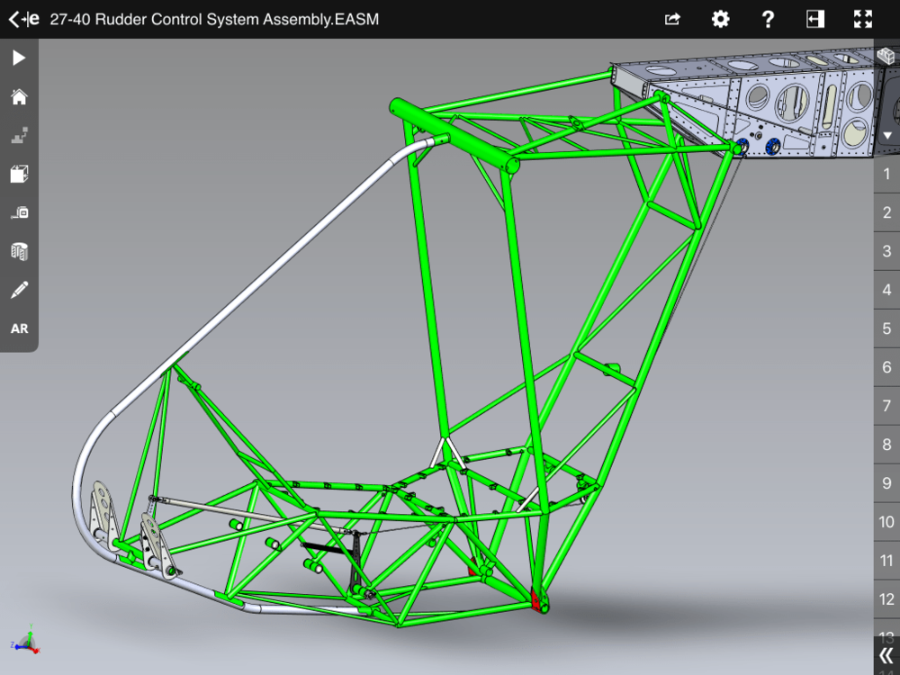
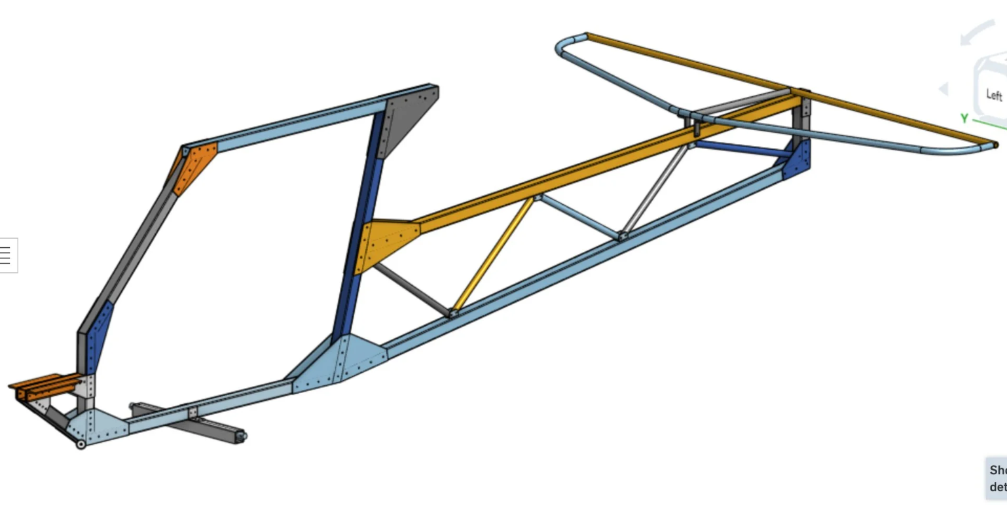
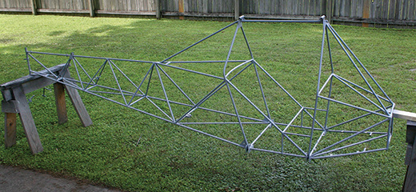
Other people’s fuselages
Notes:
Make sure to let them know the top left picture is from a design called the affordaplane
Alex

Slide 7
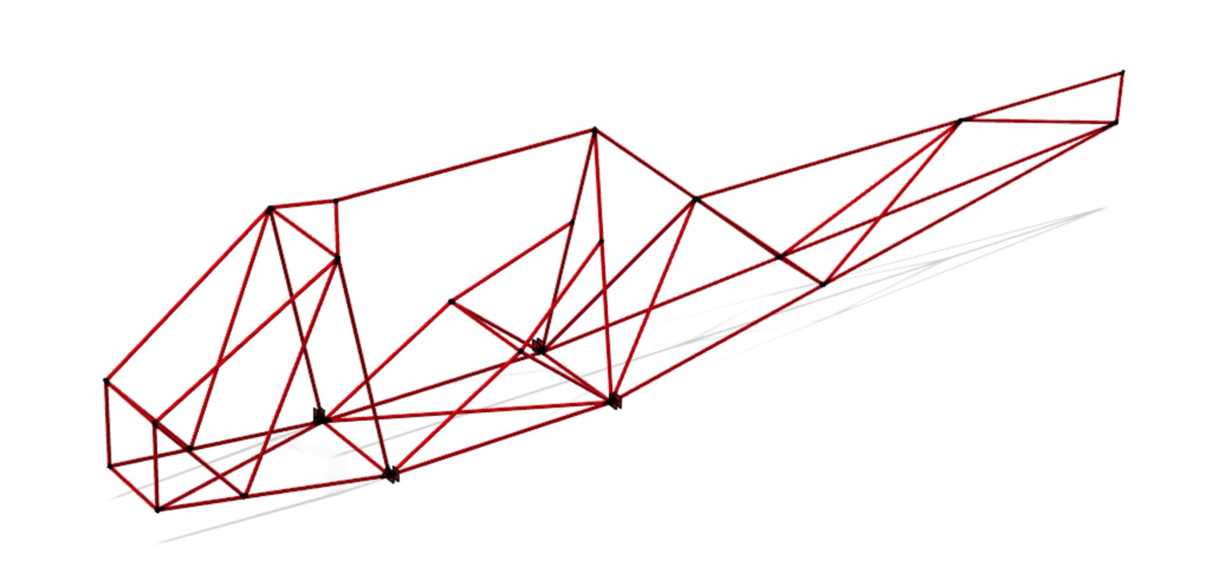
It looks like this! (our design in Fusion)
Notes:
Alex

Slide 8
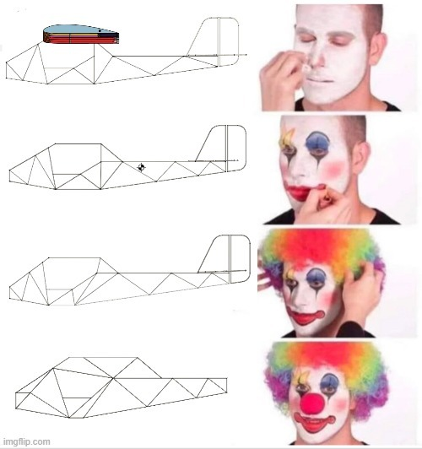
Let’s just say that we went through many iterations...
Notes:
Maya

Slide 9
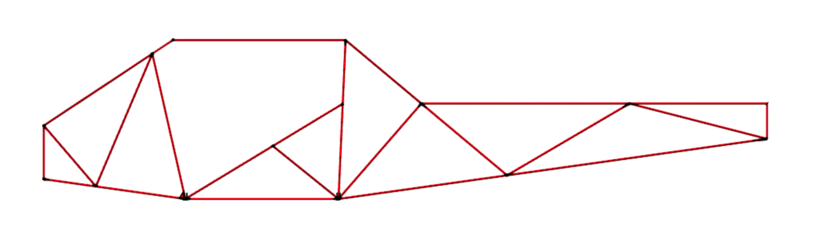
Longeron
Nose
Empennage
Cabin
Notes:
Alex

Slide 10
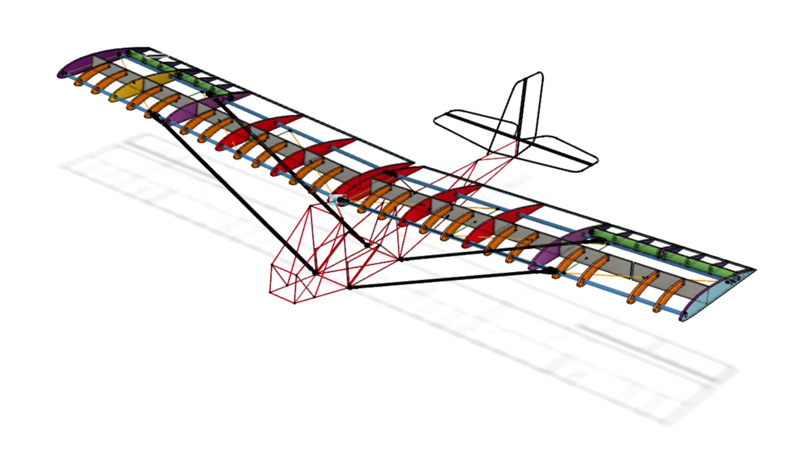
Note: struts and spars connect the wings to the fuselage
Notes:
Maya

Slide 11
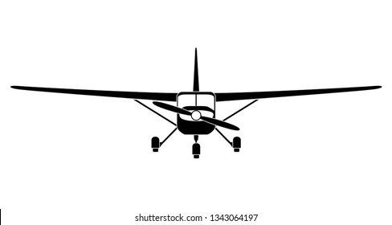
Struts
The lift produced from the wings produces high moment, so to combat this, struts are installed
Notes:
Maya

Slide 12
Trivia!
What’s a difference between our fuselage and the affordaplane’s?
Notes:
Alex

Slide 13
Answer:
The affordaplane’s is 2D, and is made of rectangular pipes, not circular ones
Notes:
Alex

Slide 14
Trivia!
What kind of metal do we use for our fuselage?
Notes:
Maya

Slide 15
Answer:
4130 chromoly steel
Notes:
Maya

Slide 16
Trivia!
What’s the name of the beam that connects the middle of each wing to the fuselage?
Notes:
Alex

Slide 17
Answer:
strut
Notes:
Alex

Slide 18
Fuselage Forces
Notes:
Maya

Slide 19
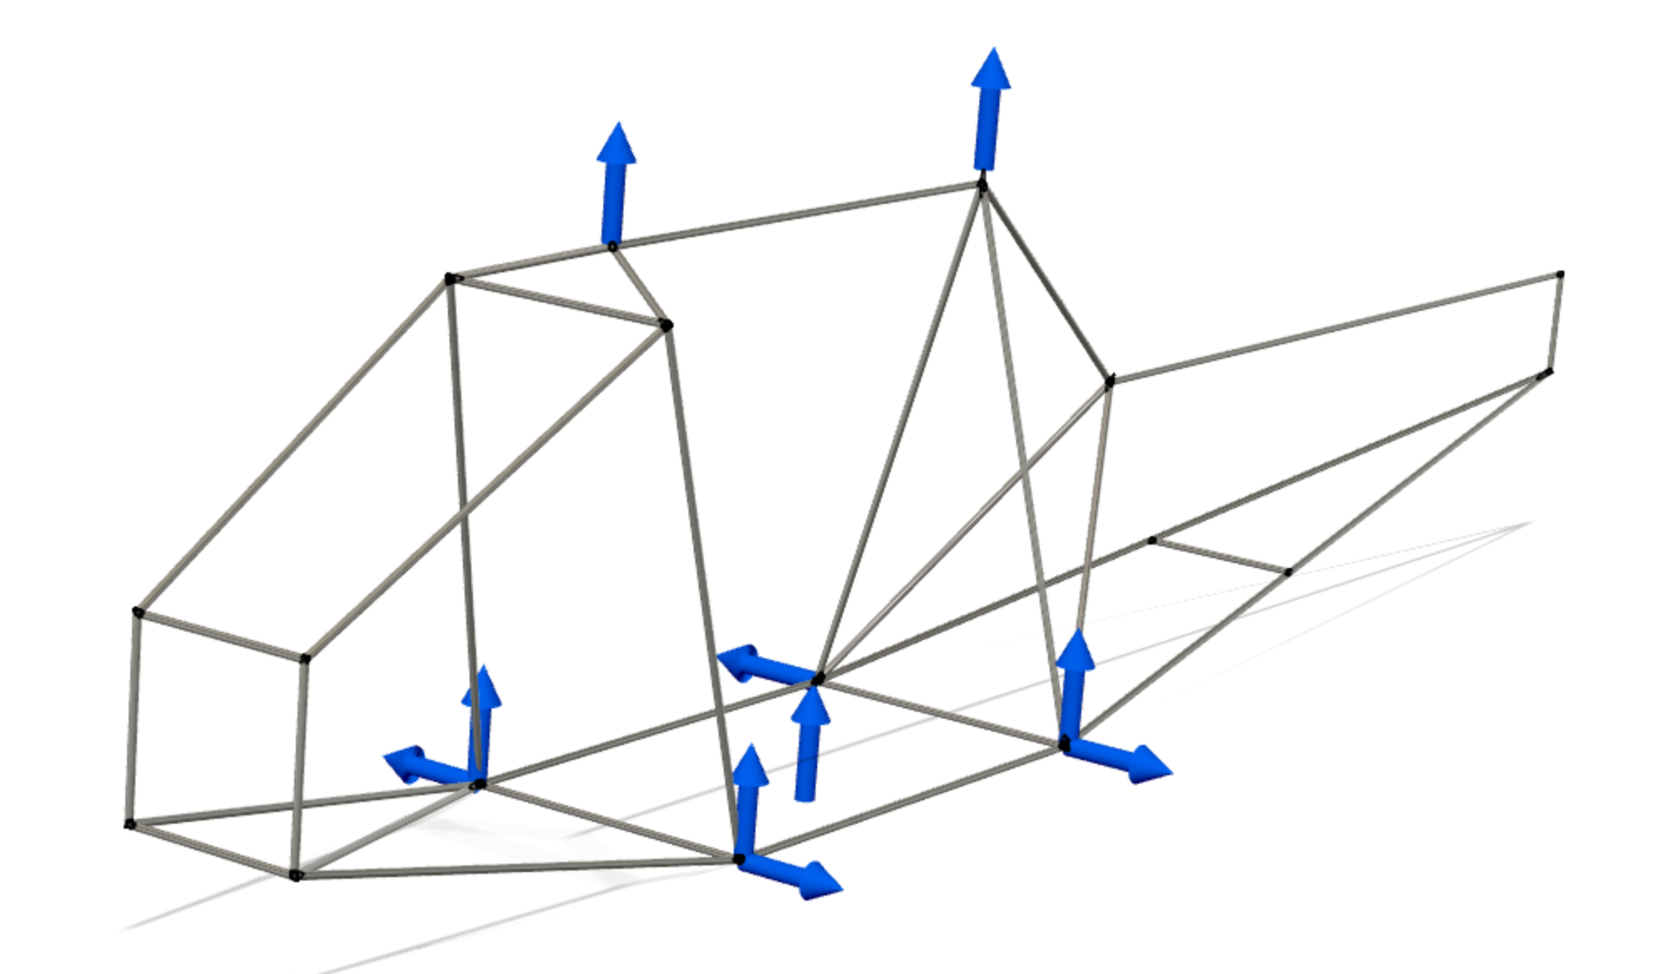
Main forces are from lift from the wings.
Forces on the fuselage are at the strut and spar attachment points
Notes:
Maya

Slide 20
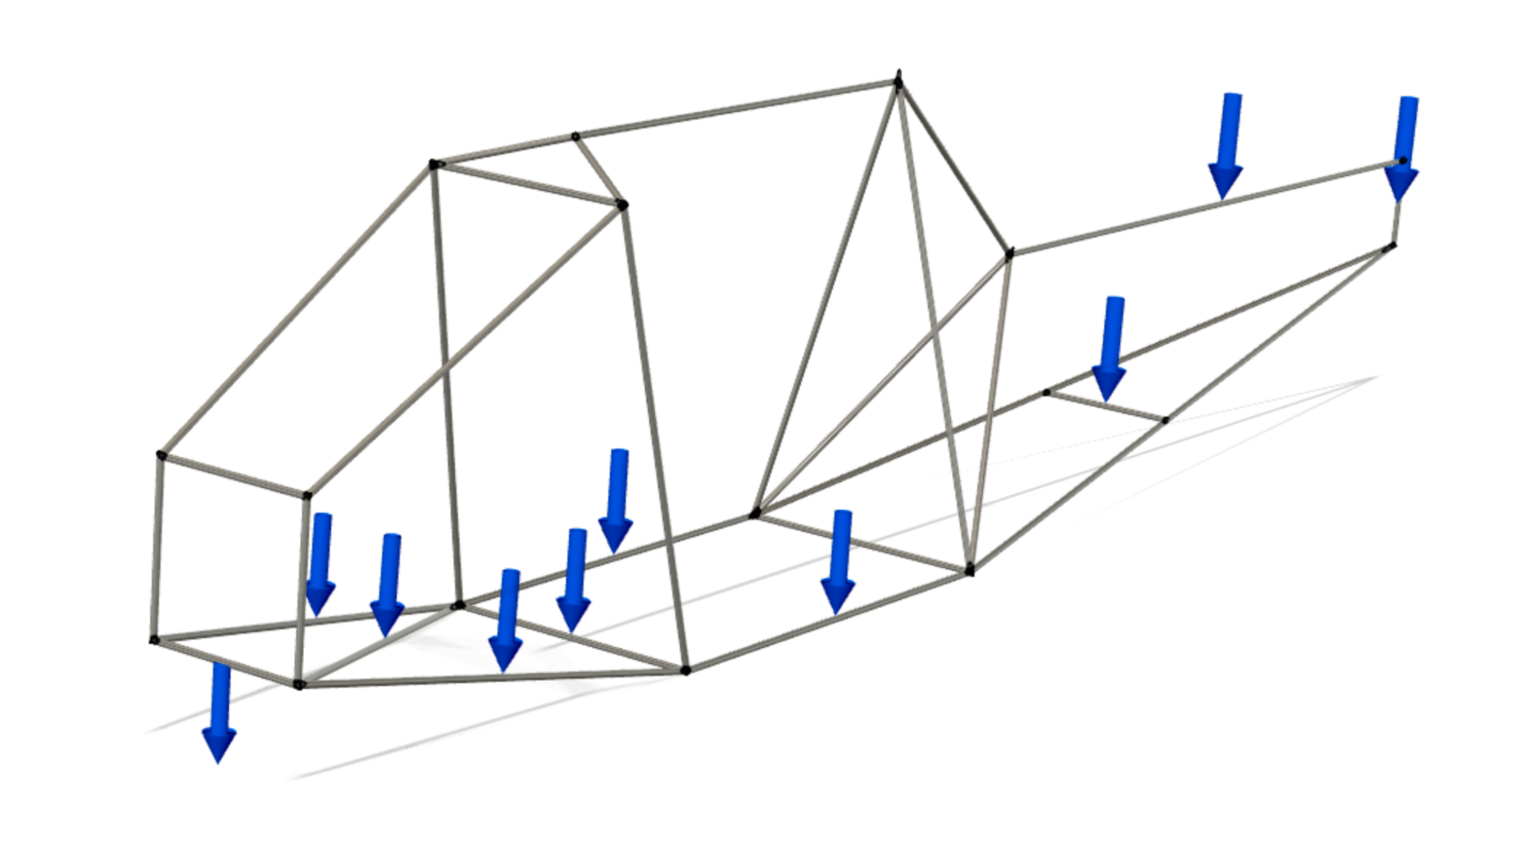
Fuselage also needs to support weight
Notes:
Alex

Slide 21
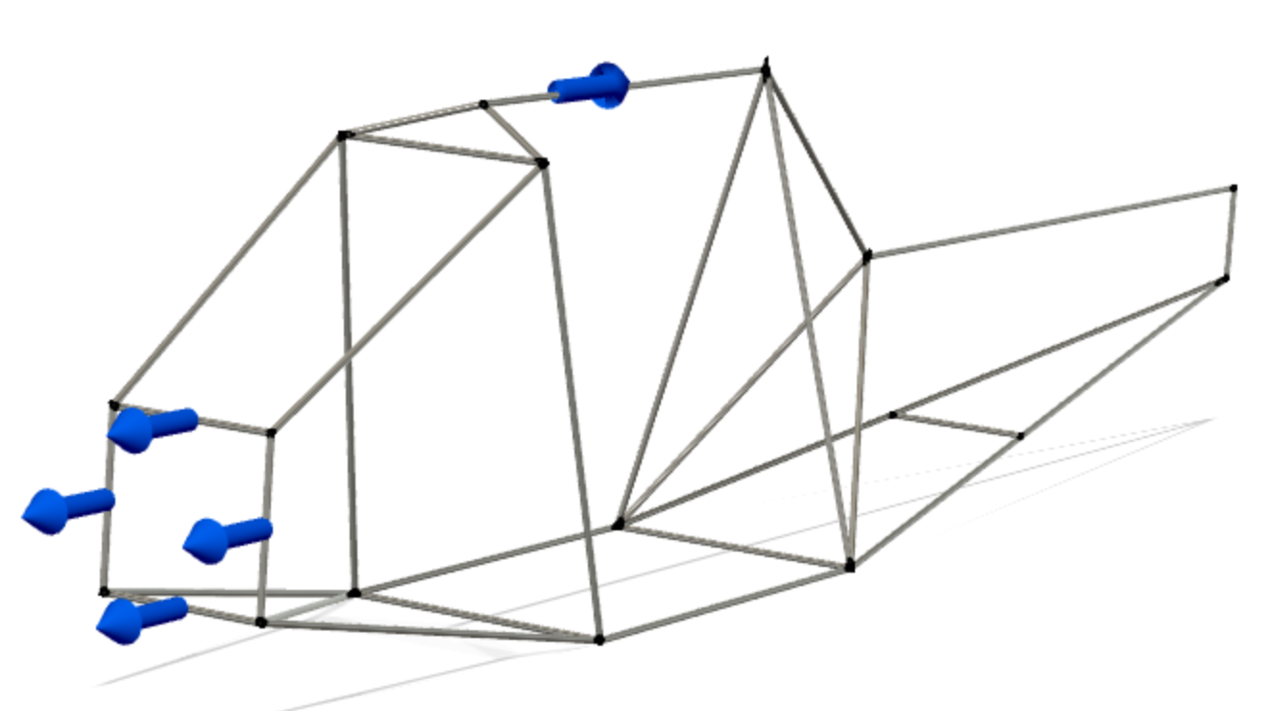
Drag and thrust also affect the fuselage (but less important)
Notes:
Maya

Slide 22
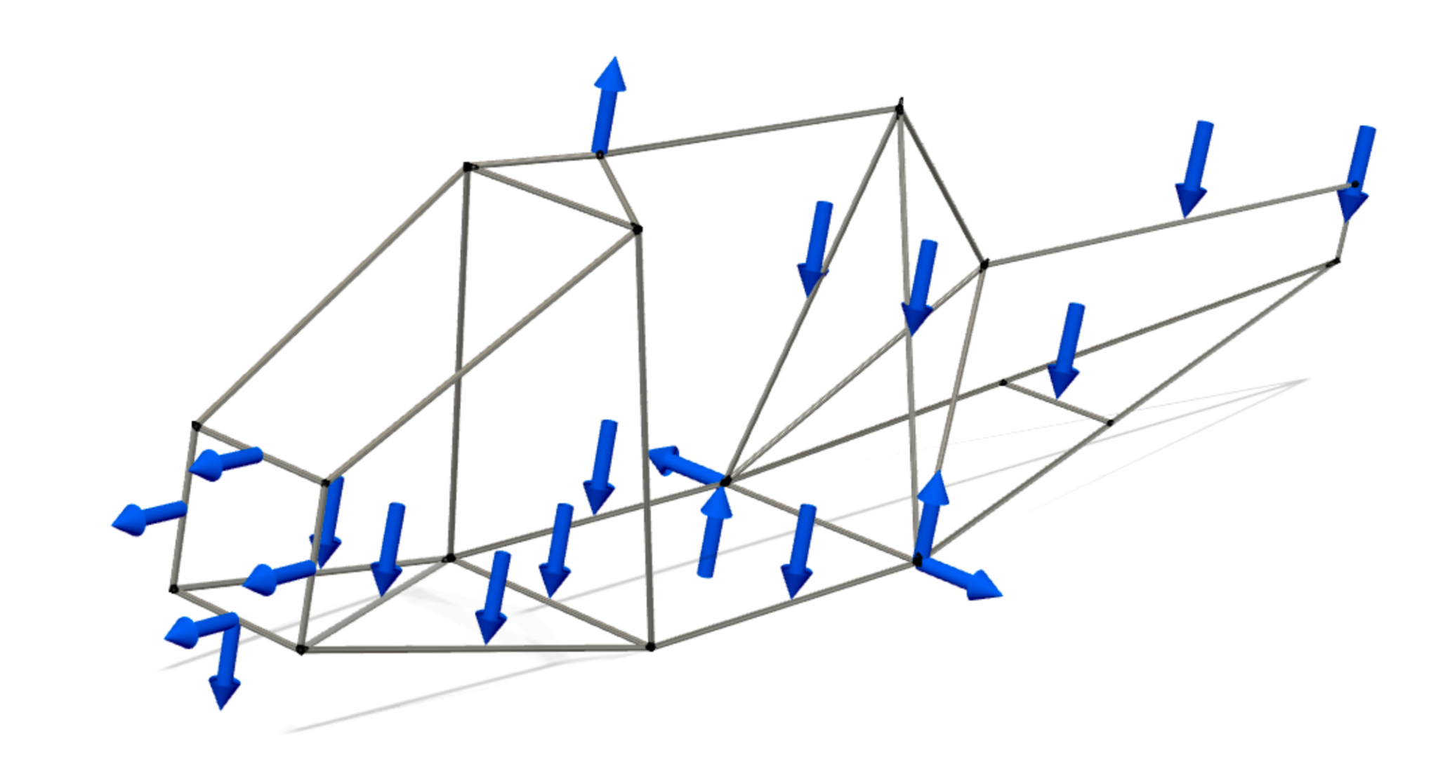
Once you add everything in the loading gets complicated.
Notes:
Alex

Slide 23
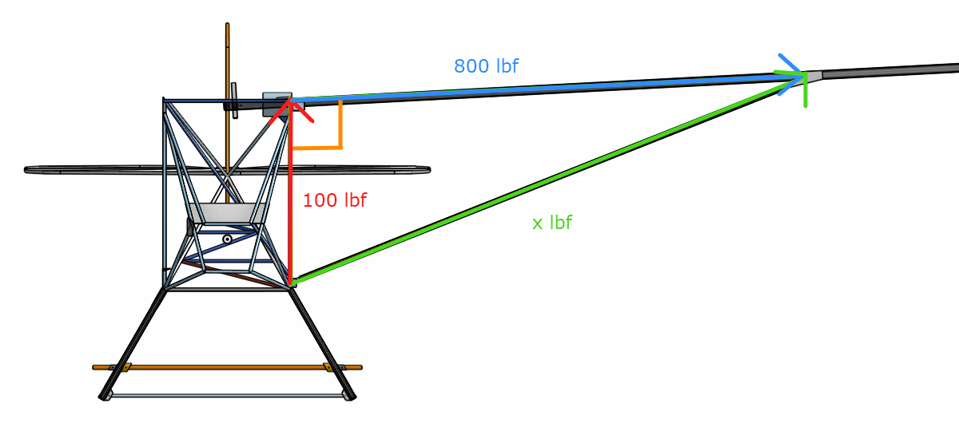
Vector Practice! - Old version of the plane
Notes:
Maya

Slide 24
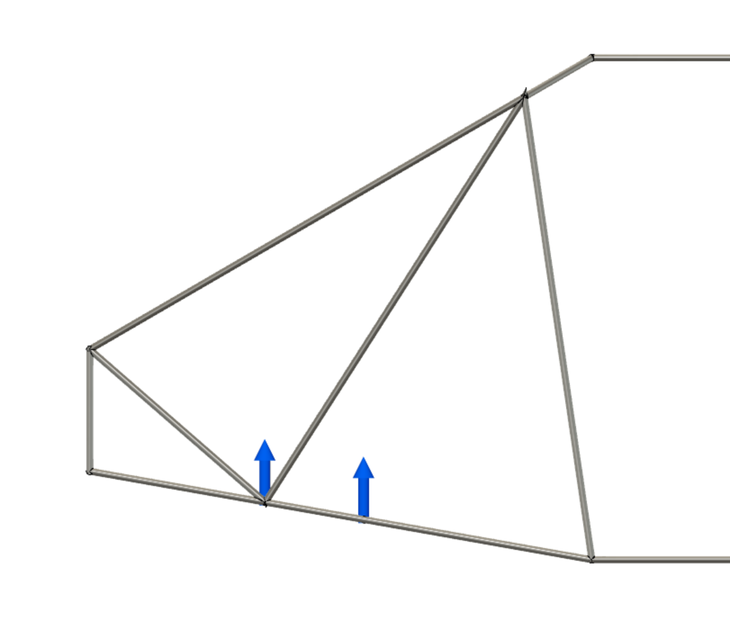
Landing
Landing is a special situation — we had to make sure the landing gear and attach were strong enough.
Notes:
Alex

Slide 25
Moment
Notes:
maya

Slide 26
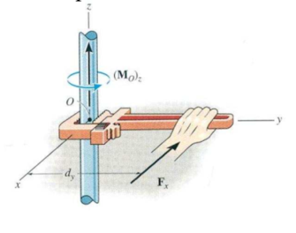
What is a moment?
A force * a distance makes a rotational moment.
Units: distance times force, ie (lbf*f, or pound feet)
If you move your hand closer to the center it will be harder to spin the rod
Notes:
alex

Slide 27
Why this matters
All moments balance around center of gravity
For example, try balancing a pencil on your finger, where it perfectly balances is around where the CG is.
A small amount of force on the tail (far from CG) has a big impact
Notes:
maya

Slide 28
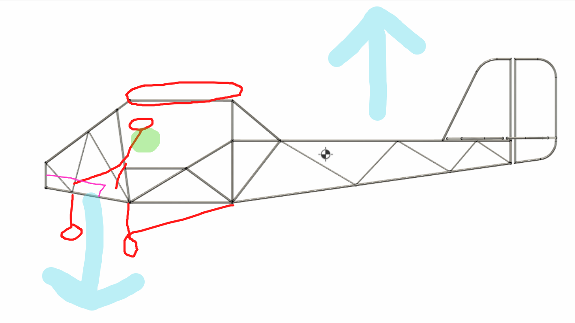
Weight is balanced on green point
Notes:
maya

Slide 29
Calculation Time!
If our tail is 15 feet from the center of gravity, and exerts 50 lbs of upwards force, what is the moment (in pound-feet) at the center of gravity?
Bonus: what’s the moment in pound-inches?
Remember:
Moment = force * distance
Notes:
Alex

Slide 30
Answer:
750 pound-feet or 9000 pound-inches
Notes:
Alex

Slide 31
What did you observe?
Which flew longer?
Best glide ratio?
(glide ratio - how far you go forward vs down)
Which flew farther?
Plane 1:
Plane 2:
Notes:
Maya Note to presenters: be ready to explain their observations →
Farthest
Slowest
Best glide ratio

Slide 32
Onwards!
Now you’ll design your own fuselage!
https://docs.google.com/presentation/d/1m8bZDU3KNS0YIf5zZQfhWM6XXz4VBbRGKAJzTL50izQ/edit?usp=sharing
Notes:
Alex

Slide 33
Small forces at large distance can HEAVILY affect the plane
Notes:
alex

Slide 34
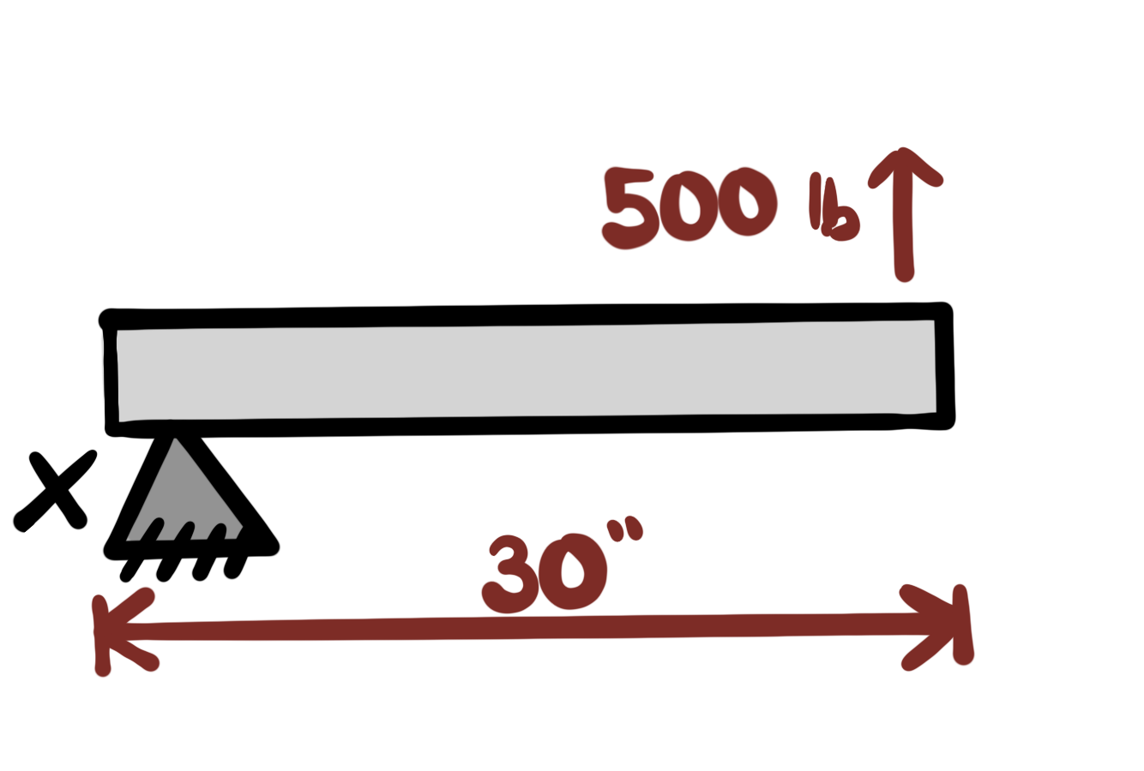
Question!
What is the moment around point x in lbi? (assuming the tube is static)
What direction will it turn? (if the tube is not static)
Notes:
agastya

Slide 35
Answer:
15000 pound inches, counterclockwise
Notes:
agastya

